Slide 1
Convex Mixture Models for Multi-view Clustering
Grigorios Tzortzis and Aristidis Likas
Department of Computer Science,
University of Ioannina, Greece

Slide 2
Outline
Introduction to Multi-view Clustering
Convex Mixture Models
Multi-view Convex Mixture Models
Experimental Evaluation
Summary

Slide 3
Outline
Introduction to Multi-view Clustering
Convex Mixture Models
Multi-view Convex Mixture Models
Experimental Evaluation
Summary

Slide 4
Clustering
Given a dataset , we aim to partition this dataset into M disjoint - homogeneous groups.
Most machine learning approaches assume the data are represented in a single feature space
In many real-life problems multi-view data arise naturally
Multi-view data are instances with multiple representations from different feature spaces, e.g. vector and/or graph spaces.

Slide 5
Examples of Multi-view Data
Web pages
Web page text
Anchor text
Hyper-links
Scientific articles
Abstract – introduction text
Citations
Such data have raised interest in a novel problem, called multi-view learning
We will focus on clustering of multi-view data
Simple solution
Concatenate the views and apply a classical clustering algorithm
Not very efficient

Slide 6
Multi-view Clustering
Given a multiply represented dataset, we aim to partition it into M disjoint - homogeneous groups, by taking into account every view.
Main challenge
The views are diverse → the algorithms must exploit this fact
Two approaches¹
Centralized
Simultaneously use all views in the algorithm
Distributed
Cluster each view independently from the others
Combine the individual clusterings to produce a final partitioning
¹ Zhou, D., Burges, C.J.C.: Spectral clustering and transductive learning with multiple views. In: Proceedings of the 24th International Conference on Machine Learning. (2007) 1159–1166

Slide 7
Existing Work (1)
Still limited, but with encouraging results
Most studies address the semi-supervised setting
Centralized methods
Bickel & Scheffer^{1,2} developed a two-view EM and a two-view k-means algorithm. They also studied mixture model estimation with more than two views
De Sa³ proposed a two-view spectral clustering algorithm, based on a bipartite graph
¹ Bickel, S., Scheffer, T.: Multi-view clustering. In: Proceedings of the 4th IEEE International Conference on Data Mining. (2004) 19–26
² Bickel, S., Scheffer, T.: Estimation of mixture models using co-em. In: Proceedings of the 16th European Conference on Machine Learning. (2005) 35–46
³ de Sa, V.R.: Spectral clustering with two views. In: Proceedings of the 22nd International Conference on Machine Learning Workshop on Learning with Multiple Views. (2005) 20–27

Slide 8
Existing Work (2)
Centralized methods – continued
Zhou & Burges¹ generalized the normalized cut to the multi-view case
Distributed methods
Long et al.² introduced a general model for multi-view unsupervised learning
¹ Zhou, D., Burges, C.J.C.: Spectral clustering and transductive learning with multiple views. In: Proceedings of the 24th International Conference on Machine Learning. (2007) 1159–1166
² Long, B., Yu, P.S., Zhang, Z.M.: A general model for multiple view unsupervised learning. In: Proceedings of the 2008 SIAM International Conference on Data Mining. (2008) 822–833

Slide 9
Our Contribution
We follow the centralized approach and propose a multi-view clustering algorithm, based on convex mixture models.
Any number of views can be handled
The diversity of the views is considered
A convex criterion is optimized to locate exemplars in the dataset
Applicable even when only the pairwise distances are available and not the dataset points

Slide 10
Outline
Introduction to Multi-view Clustering
Convex Mixture Models
Multi-view Convex Mixture Models
Experimental Evaluation
Summary

Slide 11
Convex Mixture Models (CMM) (1)
CMMs¹ are simplified mixture models
Soft assignments of data to clusters
Extraction of representative exemplars (cluster centroids)
Given the CMM distribution is:
q_{j} prior probabilities, f_{j}(x) exponential family distribution centered at x_{j}
d_{φ}(x, x_{j}) Bregman divergence corresponding to f_{j}(x)², β constant, C(x) depends only on x
¹ Lashkari, D., Golland, P.: Convex clustering with exemplar-based models. In: Advances in Neural Information Processing Systems 20. (2008) 825–832
² Banerjee, A., Merugu, S., Dhillon, I.S., Ghosh, J.: Clustering with Bregman divergences. J. Machine Learning Research 6 (2005) 1705–1749

Slide 12
Convex Mixture Models (CMM) (2)
Differences to standard mixture models
The number of components is equal to N (dataset size)
All data points are considered as possible exemplars
Exponential family distributions are used for the components
Hence, a bijection exists with Bregman divergences
The mean of the j-th distribution is equal to x_{j}
The only adjustable parameters are the components’ prior probabilities q_{j}
q_{j} is a measure of how likely point x_{j} is to be an exemplar
Parameter β
Controls the sharpness of the components
Controls the number of identified exemplars-clusters → Higher β results in more clusters

Slide 13
Clustering with CMMs (1)
Maximize the log-likelihood over q_{j} :
Minimize the KL divergence over q_{j} :
the dataset empirical distribution
the entropy of the empirical distribution

Slide 14
Clustering with CMMs (2)
The previous optimization problem is convex
Avoid poor solutions due to bad initializations, which is a common problem for mixture models optimized with EM
Solved with an efficient-iterative algorithm that always locates the globally optimal solution:
Selecting an appropriate β value
Lashkari & Golland propose the following reference value:

Slide 15
Advantages of CMMs
Convexity of the optimization function
Require only the pairwise distances of the data, not the data points
The method can be extended to any proximity data
Capable of outperforming fully parameterized Gaussian mixture models (experiments of Lashkari & Golland)

Slide 16
Outline
Introduction to Multi-view Clustering
Convex Mixture Models
Multi-view Convex Mixture Models
Experimental Evaluation
Summary

Slide 17
Multi-view CMMs
Motivated by the potential of CMMs, our work extends them to the multi-view setting following the centralized approach.
Target
Locate exemplars in the dataset, around which the remaining instances will cluster, by simultaneously considering all views
Challenges
Applicable for any number of views
The diversity of the views
Retain the convexity of the original single-view CMMs
Require only the pairwise distance matrix to work

Slide 18
Multi-view CMMs – Model (1)
Given a dataset , with N instances and V views:
Define for each view:
An empirical distribution
A CMM distribution
Minimize the sum of the KL divergences between the empirical and the CMM distributions of each view over q_{j}
Common priors across all views → High quality exemplars based on all views
Different β and Bregman divergence among views → Capture the views’ diversity
The optimization problem remains convex

Slide 19
Multi-view CMMs – Model (2)
The minimization is done analogously to the single view case
q_{j} is a measure of how likely point x_{j} is to be an exemplar, taking into account every view
Solved with an efficient-iterative algorithm that requires only the pairwise distances for each view:
Challenges - Advantages
Applicable for any number of views ✔
The diversity of the views ✔
Retain the convexity of the original single-view CMMs ✔
Require only the pairwise distance matrix to work ✔
☺

Slide 20
Clustering with Multi-view CMMs (1)
Split the dataset into M disjoint clusters
Determine the instances with the M highest q_{j} values
These instances serve as the exemplars of the clusters
Assign each of the remaining N-M data points to the cluster with the largest posterior probability over all views:
the prior of the k-th exemplar
the component distribution in the v-th view of the k-th exemplar

Slide 21
Clustering with Multi-view CMMs (2)
Selecting appropriate β^{v} values for the views
The single-view reference value is directly extended to the multi-view case:
Computational complexity
The update of the priors requires O(N²V) scalar operations per iteration
Calculation of the distance matrices of the views costs O(N²Vd), d = max {d¹, d², …, d^{v}}
If τ iterations are required, the overall cost becomes O(N²V(d+τ)) scalar operations

Slide 22
Outline
Introduction to Multi-view Clustering
Convex Mixture Models
Multi-view Convex Mixture Models
Experimental Evaluation
Summary

Slide 23
Experimental Evaluation (1)
We compared single view and multi-view CMMs on:
Artificial multi-view data
Two collections of linked documents, where multiple views occur naturally
Goals
Examine if simultaneously considering all views improves the clustering of the individual views
Compare our multi-view algorithm to a single view CMM applied on the concatenation of the views

Slide 24
Experimental Evaluation (2)
Gaussian CMMs are employed in all experiments
The algorithms’ performance is measured in terms of average entropy
Measures the impurity of the clusters
Lower average entropy indicates that clusters consist of instances belonging to the same class

Slide 25
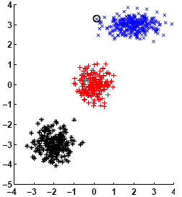
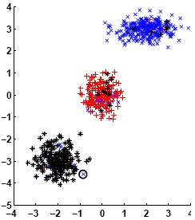
Artificial Dataset
We generated 700 instances from three 2-d Gaussians
Each distribution represented a different class
Correctly clustered by the single view CMM, i.e. H=0
Views’ construction
Equally translated all dataset points
ω instances of the original dataset were wrongly represented as belonging to another class
Five views were created
Can we correct the errors of the individual views if multiple representations are simultaneously considered?

Slide 26
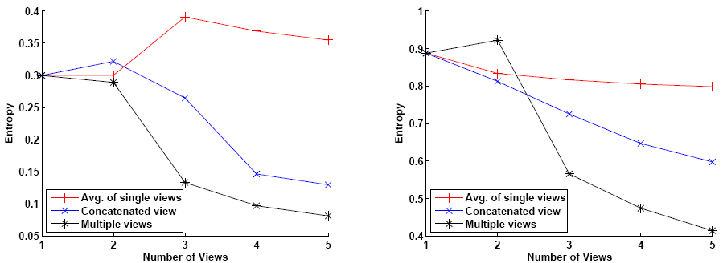
Artificial Dataset - Results
Five datasets were created containing 1,2,…,5 of the five views
Clustering into three clusters
ω = 50
ω = 200

Slide 27
Artificial Dataset - Conclusions
The multi-view CMM can considerably boost the clustering performance
Each single view has an entropy around 0.3 for ω=50
Our method achieves H=0.08 for five views and ω=50
Our algorithm takes advantage of every available view, since the entropy constantly falls as the views increase
Concatenating the views is not as efficient as a multi-view algorithm

Slide 28
Document Archives
WebKB – Collection of academic web pages
Text
Anchor text of inbound links
Six classes
2076 instances
Citeseer – Collection of scientific publications
Title & abstract text
Inbound references
Outbound references
Six classes
742 instances
2 views
3 views

Slide 29
Document Archives - Results
Clustering into six clusters
For each view we generated normalized tfidf vectors
Hence, squared Euclidean distances reflect the commonly used cosine similarity

Slide 30
Document Archives - Conclusions
The multi-view CMM is the best performer in all cases
The concatenated view is inferior to some single views
Searching around the range of values defined by can improve the results
Still though is a good choice, since the inbound references view and the multi-view setting of the Citeseer dataset achieve the lowest entropy for

Slide 31
Outline
Introduction to Multi-view Clustering
Convex Mixture Models
Multi-view Convex Mixture Models
Experimental Evaluation
Summary

Slide 32
Summary
We have presented the multi-view CMM a method that:
Is applicable for any number of views
Can handle diverse views
Optimizes a convex objective
Requires only the pairwise distance matrix
In the future:
Compare our algorithm to other multi-view approaches
Use multi-view CMMs in conjunction with other clustering methods, which will treat the exemplars as good initializations
Assign different weights to the views and learn those weights automatically

Slide 33
Thank you for your attention!

